Slide 1
Welcome to our Global Sales Celebration session March 13 and 14, 2024!!
The Data Protection Team is proud to announce that Colt was recently awarded by the new ISO 27701 Privacy Certification that will be a differentiator for the selling cycle for large customer and government entities deals.
You will be able to use the ISO 27701 Privacy Certification in RFPs and show it to Customers as a tangible evidence of Colt's highest commitment with Security and Privacy Compliance.
As well as Colt was the 1st Telecom company obtaining the approval of the Binding Corporate Rules (BCRs), now, Colt is the 1st Telecom company in being certified in this ISO in a country by country level, not only for all Colt EU countries but, also, for India!!!.
This award is the result of a great teamwork and collaboration among Colt Countries and Business Units. Let's use it as a unique competitive advantage!
Dear Global Sales Teams,
The DP Team invites you to the session on
New ISO 27701 Privacy Certification as a selling Global competitive advantage on the TOP of the BCRs.
March 13 and 14
We count on you

Slide 2
New ISO 27701 Privacy Certification as a selling Global competitive advantage on TOP of the BCRs

Slide 3
Agenda
What is the ISO27701 Privacy Certification
As a selling Global Competitive Advantage
On TOP of the BCRs
Q&A
1
2
3
4
3

Slide 4
New ISO27701 Privacy Certification

Slide 5
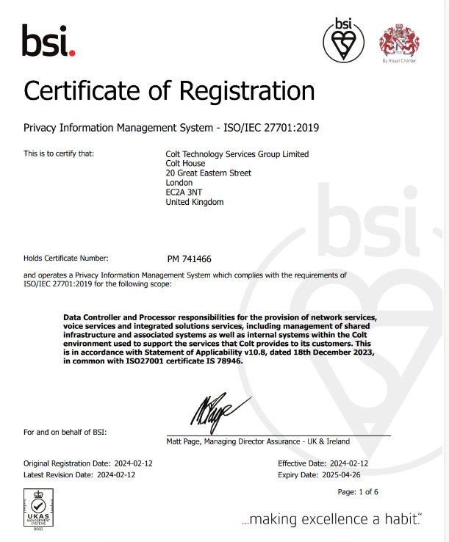
Pleased to announce that Colt achieved ISO27701 Privacy Certification
The Data Protection Team is proud to announce that Colt was recently awarded by the new ISO 27701 Privacy Certification that will be a differentiator for the selling cycle for large customer and government entities deals.
You can find the .pdf Certification on:
The Intranet - http://connect.internal.colt.net/team/legal-comp-sec/data-protection/iso27701-certification/
The Data Protection SharePoint here
The Colt.net site here

Slide 6
The scope of ISO27701 Privacy Certification for Colt is:
ISO27701
COLT CORE
ONLY
EUROPEAN COUNTRIES
ALSO INDIA
ALL BUSINESS ACTIVITIES
You will be able to use the ISO 27701 Privacy Certification in RFPs and show it to Customers as a tangible evidence of Colt's highest commitment with Security and Privacy Compliance.
Austria
Belgium
Denmark
France
Germany
Ireland
Italy Netherlands Portugal Romania
Spain
Sweden
Switzerland
United Kingdom

Slide 7
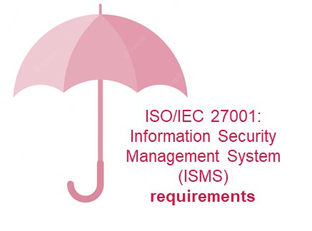
Let us tell you what ISO27701 Privacy Certification is
ISO 27701:2019 is a data privacy extension to ISO 27001. It requires an underlying ISO 27001 implementation.
This Global standard provides the framework for organizations looking to put in place a system to support compliance with the EU’s GDPR, California’s CCPA, and other data privacy requirements. It is a Global Compliance certification on Privacy and Security standards to protect Personal Data or Personal Identifiable Information (PII) for Controllers and Processor through a PIMS framework or (Privacy Information Management System).
Certification Body
BSI was the accredited certified body who audited the standards checklist compliance controls to provide the certification.
Does it need further maintenance?
ISO 27701 should be partially audited in a year basis, externally, for maintenance
ISO 27701 need to be audited for renewal every 3 year basis

Slide 8
Can you imagine which the benefits of ISO27701 for Colt are? We tell you:
1.- Demonstrate Reliability and Trust. With a certification and/or quality label, companies have the opportunity to demonstrate their reliability to their surroundings, such as purchasers, suppliers, business partners and government. Reliability is an abstract term and is expressed in quality, safety, environment and durability of products and/or services.
2.- Well- known 3rd certified body (BSI auditor) and International Standard Organisation used (ISO (International Organization for Standardization), an independent, non-governmental, international organization that develops standards to ensure the quality, safety, and efficiency of products, services, and systems).
3.-Meet requirements of international legislation and regulation. With an ISO standard, companies demonstrate that they meet the requirements of international legislation and regulation and adhere to these. An ISO certificate also ensures a reduced risk of liability. Companies show that they are a serious player, which strengthens their competitive position.
4.- To participate and be considered in tenders and RFPs. Particularly in the field of tendering, it’s important that companies have an ISO certificate. ISO can also be a requirement to be considered for orders by large contractors or from decentralised government.
5. Consistency of standards and quality across industries and nations.

Slide 9
The DP team managed to get the Certification in several languages as we knew it was important in some countries:
English
Italian
French
Spanish
German

Slide 10
ISO 27701 as a selling Global competitive advantage

Slide 11
Most importantly, these are the key messages that the Sales Teams can use to put ISO27701 in value before Customers:
ISO27701 helps Colt to protect Personal Data or (Personal Identifiable Information, “PII”)
Colt is now the only one Telecom company to have been granted the ISO27701 certification on a country-by-country basis for both controller and processor.
Using ISO 27701 as the standard for data security and privacy shows customers and stakeholders that Colt supports Global compliance with Privacy Rules.
ISO27701 reduces information security and privacy risks for individuals and by using the controls, Colt achieves a more trustworthy brand.
ISO27701 outlines a framework to manage privacy controls for Personal Data or “PII” when the company is handling Personal Data as Data Controller or Data Processor as it establishes a Privacy Information Management System / PIMs.
11
Notes:
ISO/IEC 27701:2019 is a privacy extension to ISO/IEC 27001. The design goal is to enhance the existing Information Security Management System (ISMS) with additional requirements in order to establish, implement, maintain, and continually improve a Privacy Information Management System (PIMS).The standard outlines a framework for Personally Identifiable Information (PII) Controllers and PII Processors to manage privacy controls to reduce the risk to the privacy rights of individuals.
The certification is expected in 2022 and your collaboration is required!!

Slide 12
How ISO27701 can be used as a competitive advantage
For sales, exponentially increases our reputation in the market as Colt is the unique telco to have this certification in such a wide scope.
Bids
Audits
ISO will place Colt in a privileged situation as no other Telco has the ISO in a country by country basis
Data Protection audits from customers will be easily closed with ISO Certification.
RFPs
Market value
No need to fill out customer RFPs, you can share the ISO Certificate with your customers.
Sales use of ISO27701
Let’s see how ISO certification increases Colt value in the market as BCRs did
Negotiations
Whenever you want!
Colt has potential customers with a heavy focus on Privacy and Security compliance. ISO can help in the choice of Colt.
It is a competitive advantage, and we must make the best of it.
Financially, ISO will help to reduce potential costs and to increase revenue with new contracts.

Slide 13
ISO 27701 on TOP of the BCRs

Slide 14
Don’t forget to get credit of Colt´s BCRs. You will find all useful information here
In 2021 Colt was the first Telco company in having BCRs (post GDPR) and this placed Colt at the forefront of Privacy compliance worldwide.

Slide 15
BCRs are a valuable competitive advantage for Colt, now, with ISO27701 on TOP of BCRs, Colt is the unique Telco with the best Privacy Compliance Certifications in the world
BCR

Slide 16
It was challenging to get the ISO27701 Privacy Certification
To be in line for the certification, Colt had to demonstrate a robust attitude towards data privacy.
Each EU country and India assigned a specific person in each business area, known as a SPOC
SPOCs in every country of different Business Units received additional training on data protection and ISO27701 requirements and controls.
Additionally all the SPOCs of each country where audited internally by an independent body and by an external accredited body who awarded Colt the ISO certification
This Project took more than 16 months of hard work and amazing collaboration

Slide 17
So we want to use this session also to be grateful with all people involved around all Countries and Business Units

Slide 18
And, we know it may not be easy to keep the highest standards, but we know, together we can!
We have a plan!
Corrective Action Plan: Ensure that we answer and update all of the actions in the corrective action plan we have put in place from the results of the audit. Make sure all comments and suggestions are ready for the audit in October 2024.
Area SPOCs: Work with the SPOCs from the different areas where we have action plans in place and to ensure that we answer in detail the comments from BSI
Simplification, automation and/or updating of DP resources
Country Managers: Work with the country managers to ensure that we have all the support required for the ISO27701 recertification

Slide 19
The DP team has placed several artefacts available for you to self- serve and optimize the use of ISO27701 Privacy Certification, more will come as per your request… so…☺ REQUEST ☺..
Please, go to the DP intranet site
To the ISO 27701 section
Where you can find the Certification document available to be provided to Customers
As well as, FAQ with additional useful information
And, some trainings available, including this one in particular , when ready.
TO US

Slide 20
Questions? (please any suggestion, question or request send it to gdpr@colt.net)

