Slide 1

Optimising Accessibility
Creating accessible PDFs with Adobe Acrobat and Microsoft Word

Slide 2




Adobe Acrobat PRO
Adobe Acrobat PRO is an application that can be found as part of Adobe Creative Suite, a paid suite of applications from Adobe.
It includes a desktop application and web version and is compatible with most platforms, including Windows and Mac.
Notes:
Things to say:
It is also available as a standalone application.

Slide 3
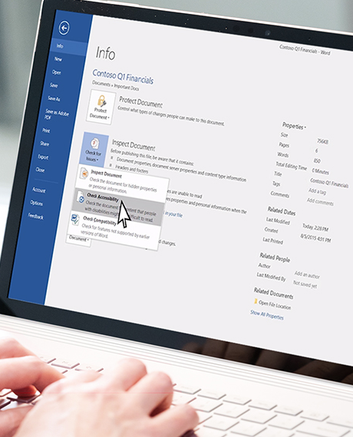
Prepare your original Word document
Prepare your document for accessibility by following the Accessible Microsoft Word guide.
Include a title and author in your Word Document.
Use the built-in functionality of Microsoft Word wherever possible, especially for headings, paragraphs, and lists.
Convert complex graphics to images to simplify PDF tagging.
Ensure tables are as simple as possible and avoid merged cells
Notes:
Things to say:
– complex table conversion from Word to PDF is not always accurate and may not be read aloud by the screen reader the way you intended.
For more complex documents, consider using Adobe InDesign as the accessibility conversion is more accurate.

Slide 4
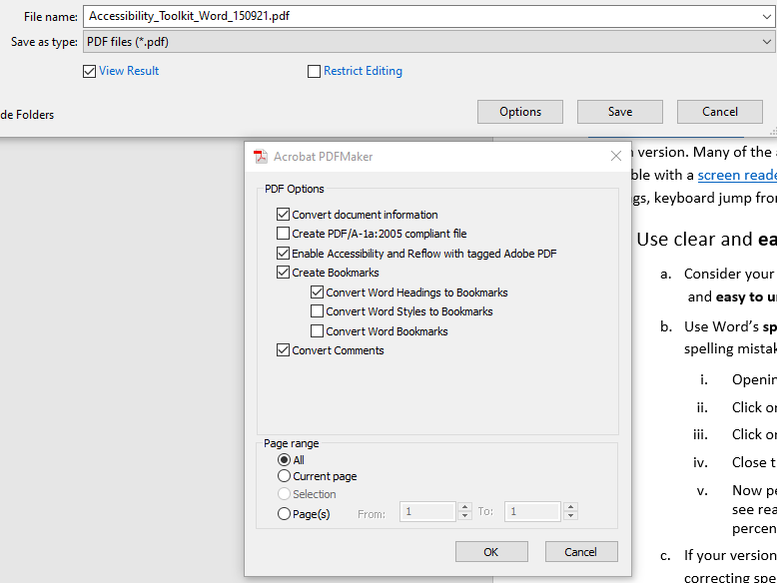
Export to PDF
In Microsoft Word, “Save as PDF”.
In Options, make sure to check “Enable accessibility.”
Press OK to save.

Slide 5
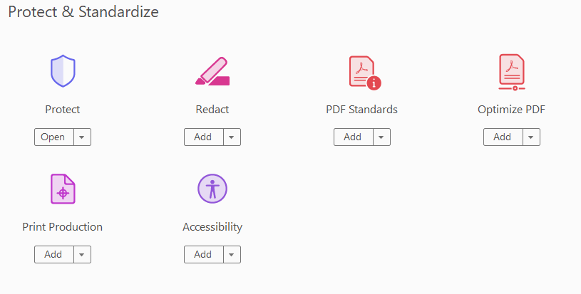
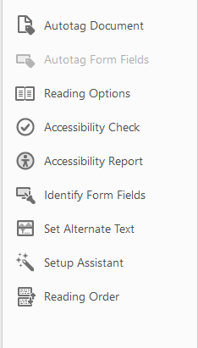
Check PDF for accessibility issues
Open your new PDF using Adobe Acrobat.
Choose the “Accessibility” option.
The more accessible your initial Word document, the better the results of the accessibility checker.
You can right-click to ‘fix’ or ‘explain’ each accessibility issue.

Slide 6
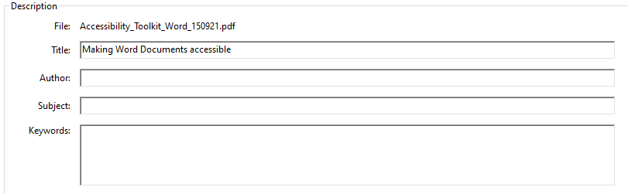
Ensure your PDF has a title
Click “File” and then choose “Properties”
Enter your document ‘Title’ in the window that appears.

Slide 7
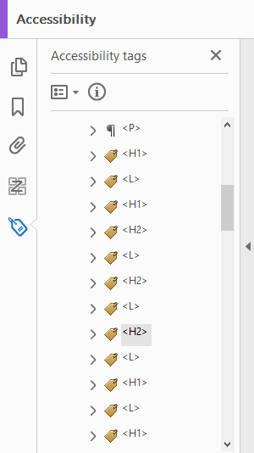
View and edit your PDF tags
When you ‘save as’ a PDF, tags are automatically added to the elements within your document like the headings, paragraphs, and figures. This makes it navigable and readable with a screen reader.
If you set up your original Word document for accessibility, your tags will be well structured, however, they can always be improved.
Check your tags manually in the tags panel and edit where appropriate.

Slide 8
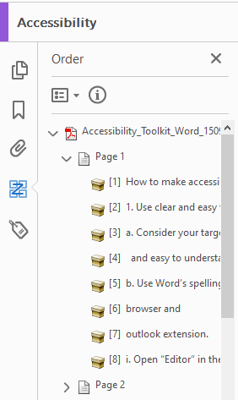
Check the reading order
Choose “reading order” in the accessibility panel.
Check the order of the numbers on the page.
  Use the reading order panel to change or add tags.
  Drag the numbered elements in the left-hand column to represent the correct reading order.
A correct reading order will ensure a screen reader will read aloud your document in the order you intended.

Slide 9
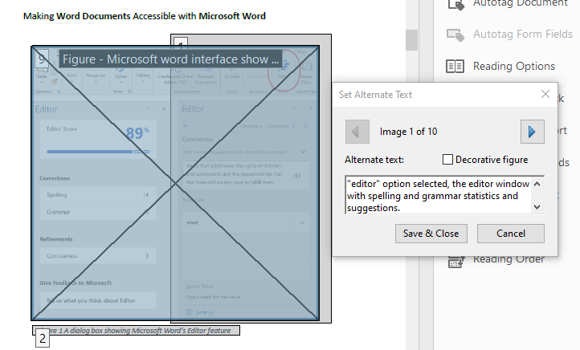
Edit the image descriptions
Ensure essential images and charts contain alternate text.
Choose “Set Alternate Text” in the accessibility panel and click “OK”.
Now, you can edit the image description on each image.
These are read aloud by a screen reader helping anyone who has difficulty seeing the content.
Mark non-essential visual elements as decorative.
For decorative graphics select “Decorative figure”, so they are not read aloud by the screen reader.

Slide 10

Colour contrast between text and background
The accessibility checker will warn you if the contrast between the text and the background is poor.
You will need to fix these by hand in your original document.
Notes:
Things to say:
Using colour to convey information can exclude some people. Such as those a visual impairment or colour blindness
Always ask yourself:
‘Do the colours I’m using have enough contrast?’

Slide 11
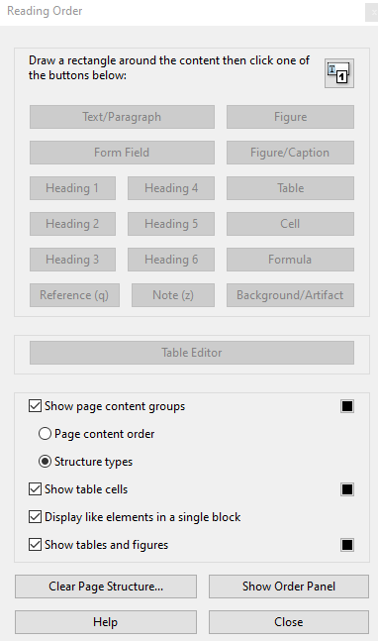
Making tables accessible
Where possible, avoid merging cells in your original file, as this will create issues for a screen reader trying to read your PDF.
If your table does not tag well or there are other issues it may be better to create the PDF in a program such as Adobe InDesign.
You can edit your table by clicking on “Reading Order” > selecting the table > then selecting “Table Editor.” Here you will be able to mark header rows and edit cell tags.
Notes:
Things to say:
Tables do not always convert well Word to PDF, especially there may be problems auto-tagging the table.
Point 2 - These can produce a better result that is more compatible with screen readers.

Slide 12
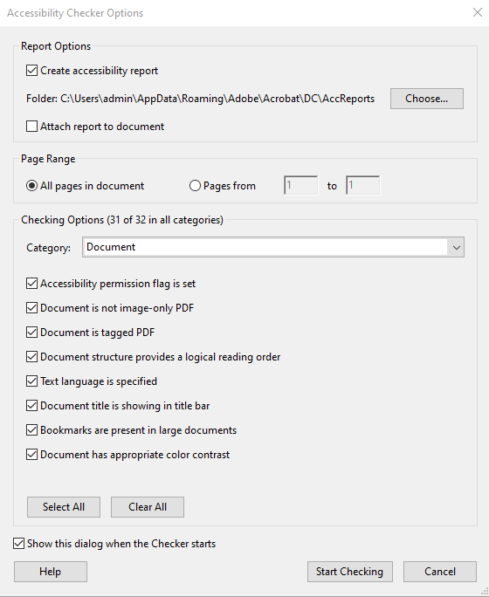
Re-check the PDF for accessibility issues
Use the “Accessibility Checker” to recheck the document ensuring all issues have been checked and corrected.
Notes:
PowerPoint has a checker to help you with this. It is a quick and simple way of making sure that there are no major accessibility challenges in your deck. Using it is simple and can be found on the review tab

Slide 13

Further sources of information
Read more about ways to make your documents accessible:
Webaim Accessible PDFs
Adobe Accessible PDFs Guide to the Checker
How to Verify PDF Accessibility

